Slide 1
Crop Production Analysis
Presentation by
Sai Krishna Tandasi

Slide 2
Contents
Introduction
Problem Statement
Process
Dashboard
Insights
Conclusion

Slide 3
Introduction
The Crop Production Analysis project aims to provide a comprehensive overview of the production and area of cultivation of various types of crops.
This analysis includes key metrics such as yearly production, seasonal attributes, state-wise analysis and offering valuable insights into economic landscape and agricultural dynamics.
The Data highlights the dominance of certain states and crops showcasing their impact on the overall market.

Slide 4
Problem Statement
The Agriculture business domain, as a vital part of the overall supply chain, is expected to highly evolve in the upcoming years via the developments, which are taking place on the side of the Future Internet.
This paper presents a novel Business-to-Business collaboration platform from the agri-food sector perspective, which aims to facilitate the collaboration of numerous stakeholders belonging to associated business domains, in an effective and flexible manner.
This dataset provides a huge amount of information on crop production in India ranging from several years. Based on the Information the ultimate goal would be to predict crop production and find important insights highlighting key indicators and metrics that influence crop production.
Make views and dashboards first and also make a story out of it.

Slide 5
Process
Data Understanding
Understood the data and found Key Performance Indicators (KPIs) of the data
Data Cleaning
Removed unnecessary columns which have no impact in KPIs
Data Analysis
Derived dominant categories in each KPI(Area and Production) with various filters
Uncovering Insights
Created visual Dashboards showing the impact of various sectors influencing the KPIs
Excel, Power Query
Derived some key visual insights
Python, Pandas, Seaborn
Microsoft Power BI

Slide 6
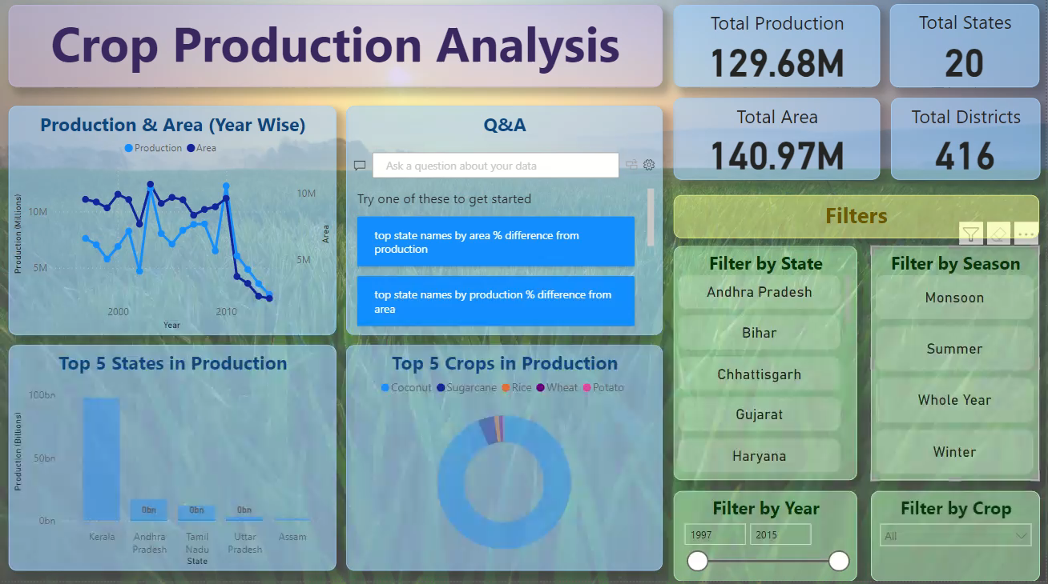
Dashboard

Slide 7
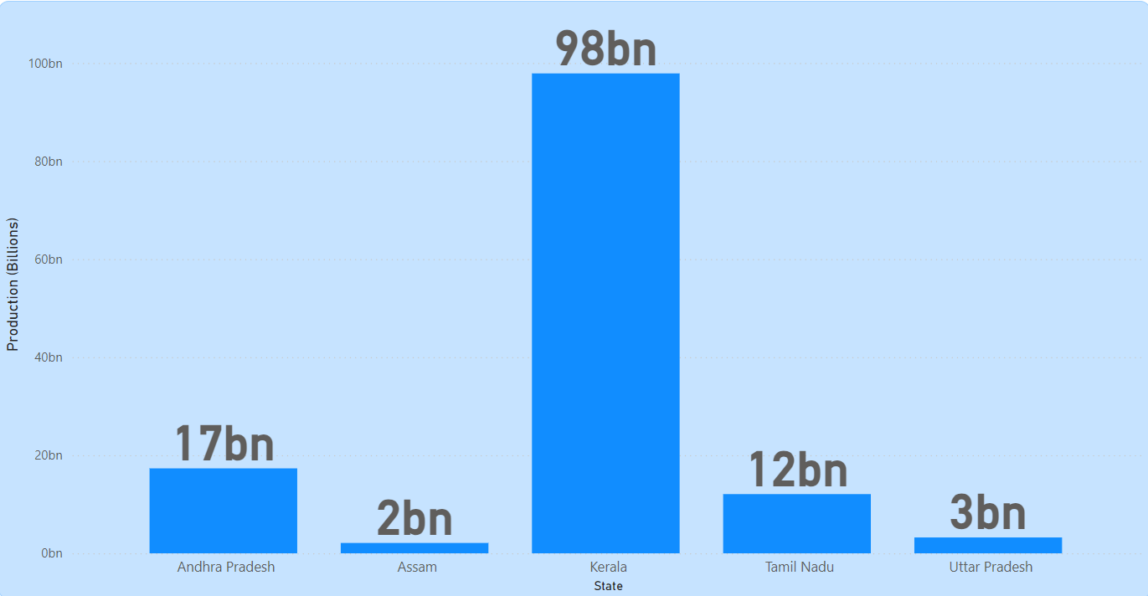
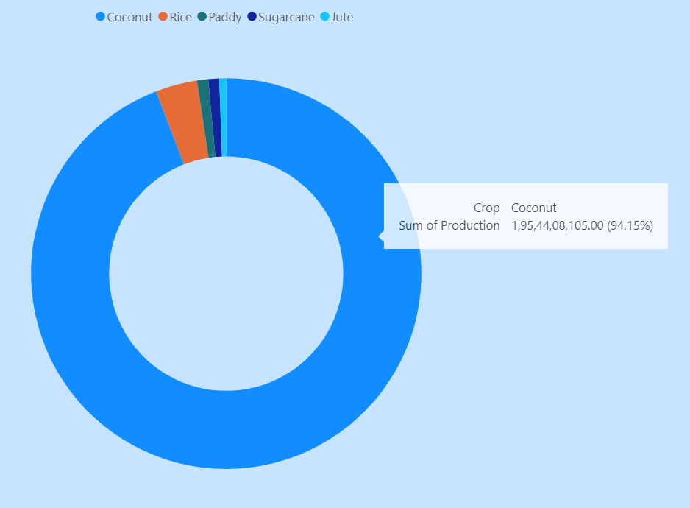
Top 5 States and Crops in Production
Kerala State is highest in Production followed by Andhra Pradesh, Tamil Nadu, Uttar Pradesh, Assam.
Coconut is leading crop in these 5 states followed by Rice, Paddy, Sugarcane, Jute

Slide 8
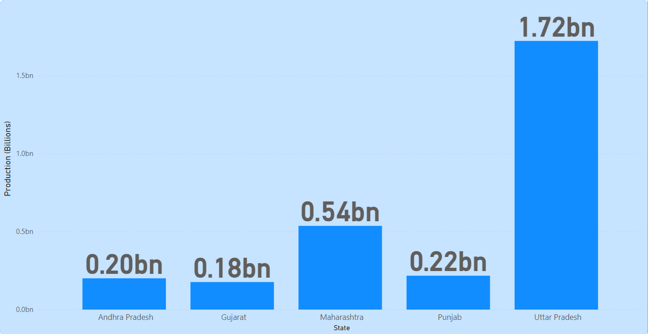
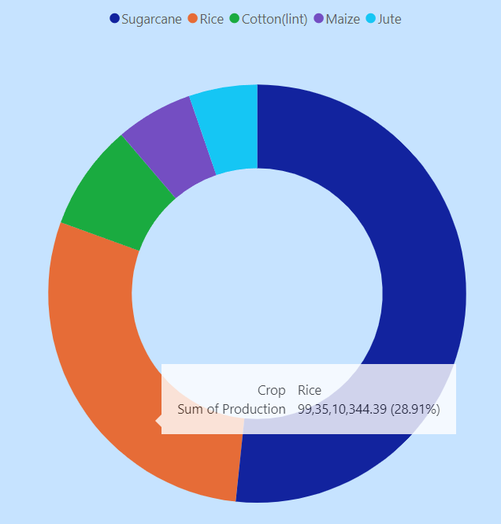
Top 5 States and Crops in Production in Monsoon
States
Crops

Slide 9
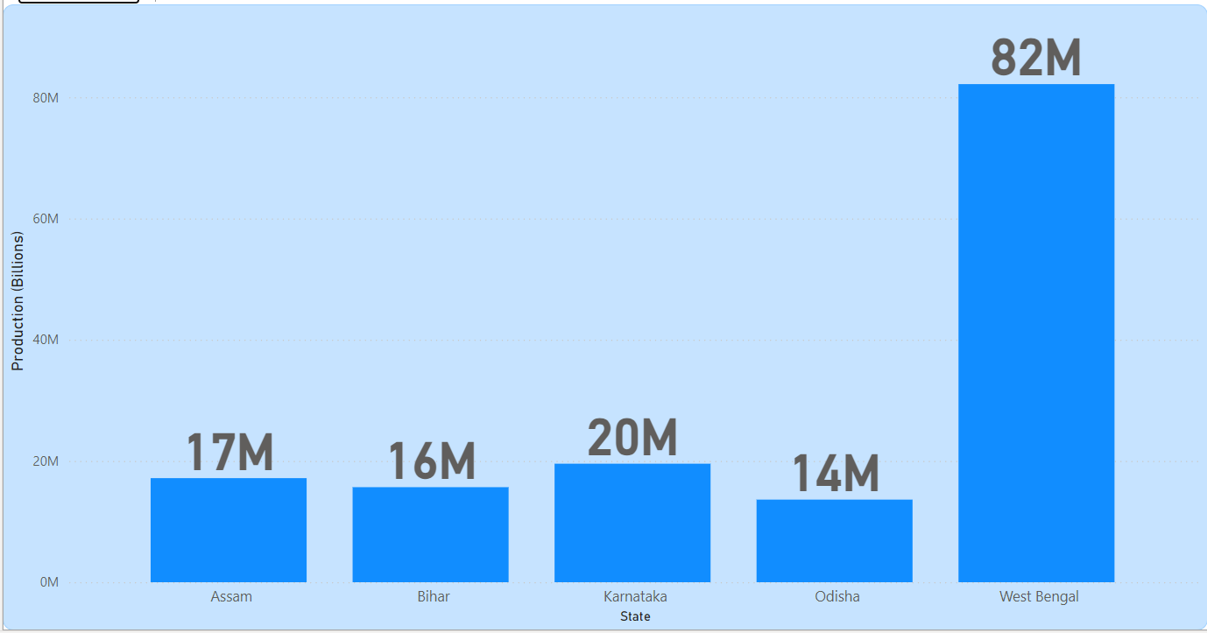
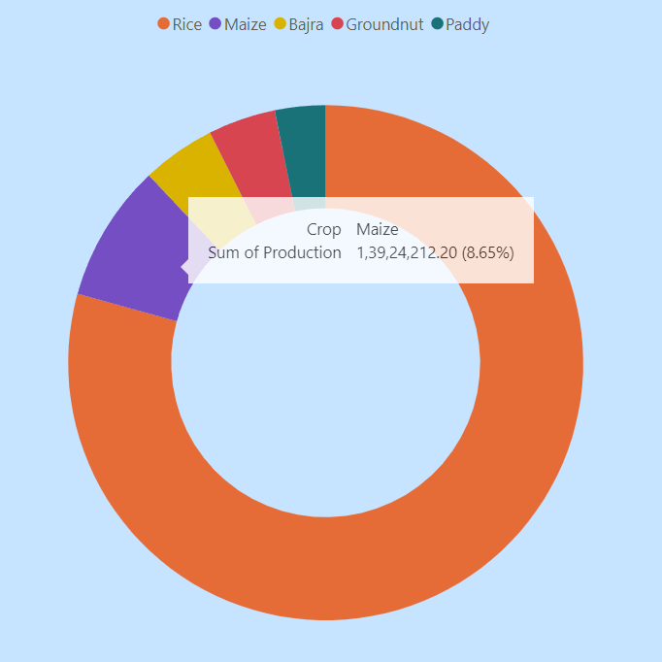
Top 5 States and Crops in Production in Summer
States
Crops

Slide 10
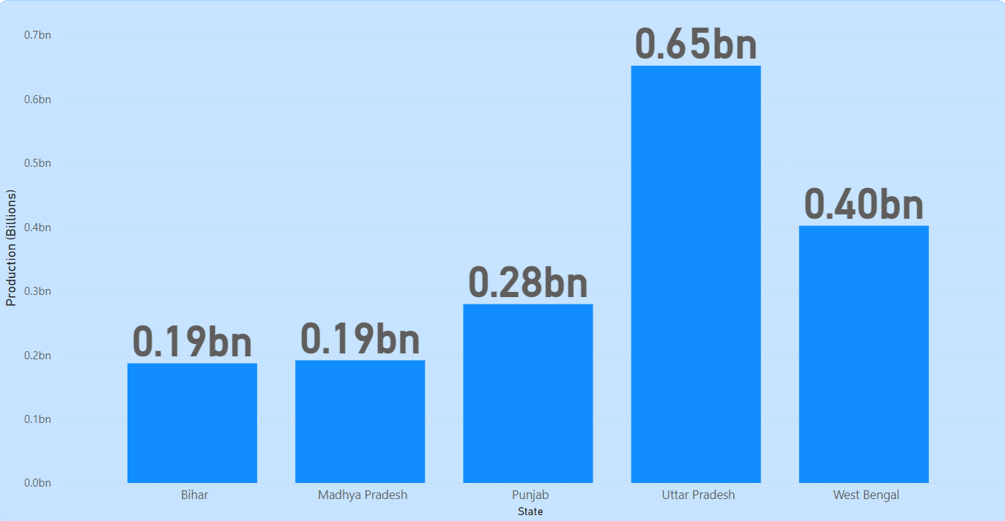
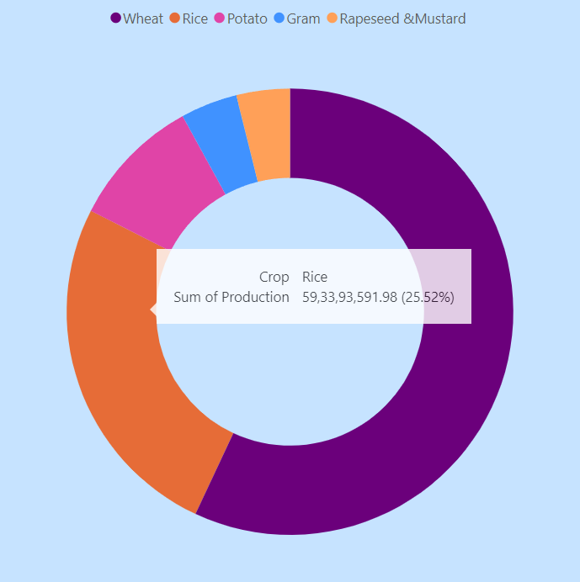
Top 5 States and Crops in Production in Winter
States
Crops

Slide 11
Conclusion
Coconut is the leading producer in India.
Kerala is the leading Producer for Coconut.
Sugarcane is the major crop in monsoon leading by Uttar Pradesh.
Rice is the major crop in Summer leading by West Bengal.
Wheat is the major crop in Winter leading by Uttar Pradesh.
Production in the year 2015 is significantly low than other years.
Power BI Link : https://app.powerbi.com/groups/me/reports/8bf8a73b-970f-461f-ad10-49e0b443b9f4?ctid=209a70f5-a678-4831-9798-ea1ea04aa9b8&pbi_source=linkShare

